Slide 1
CS 347 Project
Conner Collins, Hunter Degroot, and Scott Jackson
Github Repo

Slide 2
Part 1
Models
Screenshots
SQL Queries

Slide 3
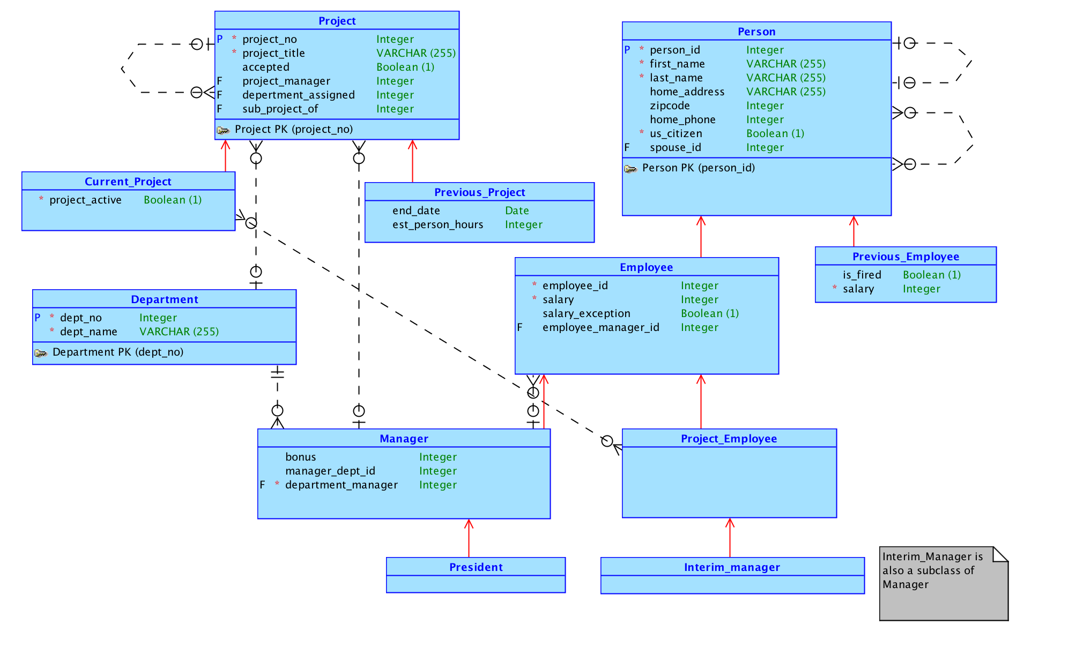
Conceptual Model

Slide 4
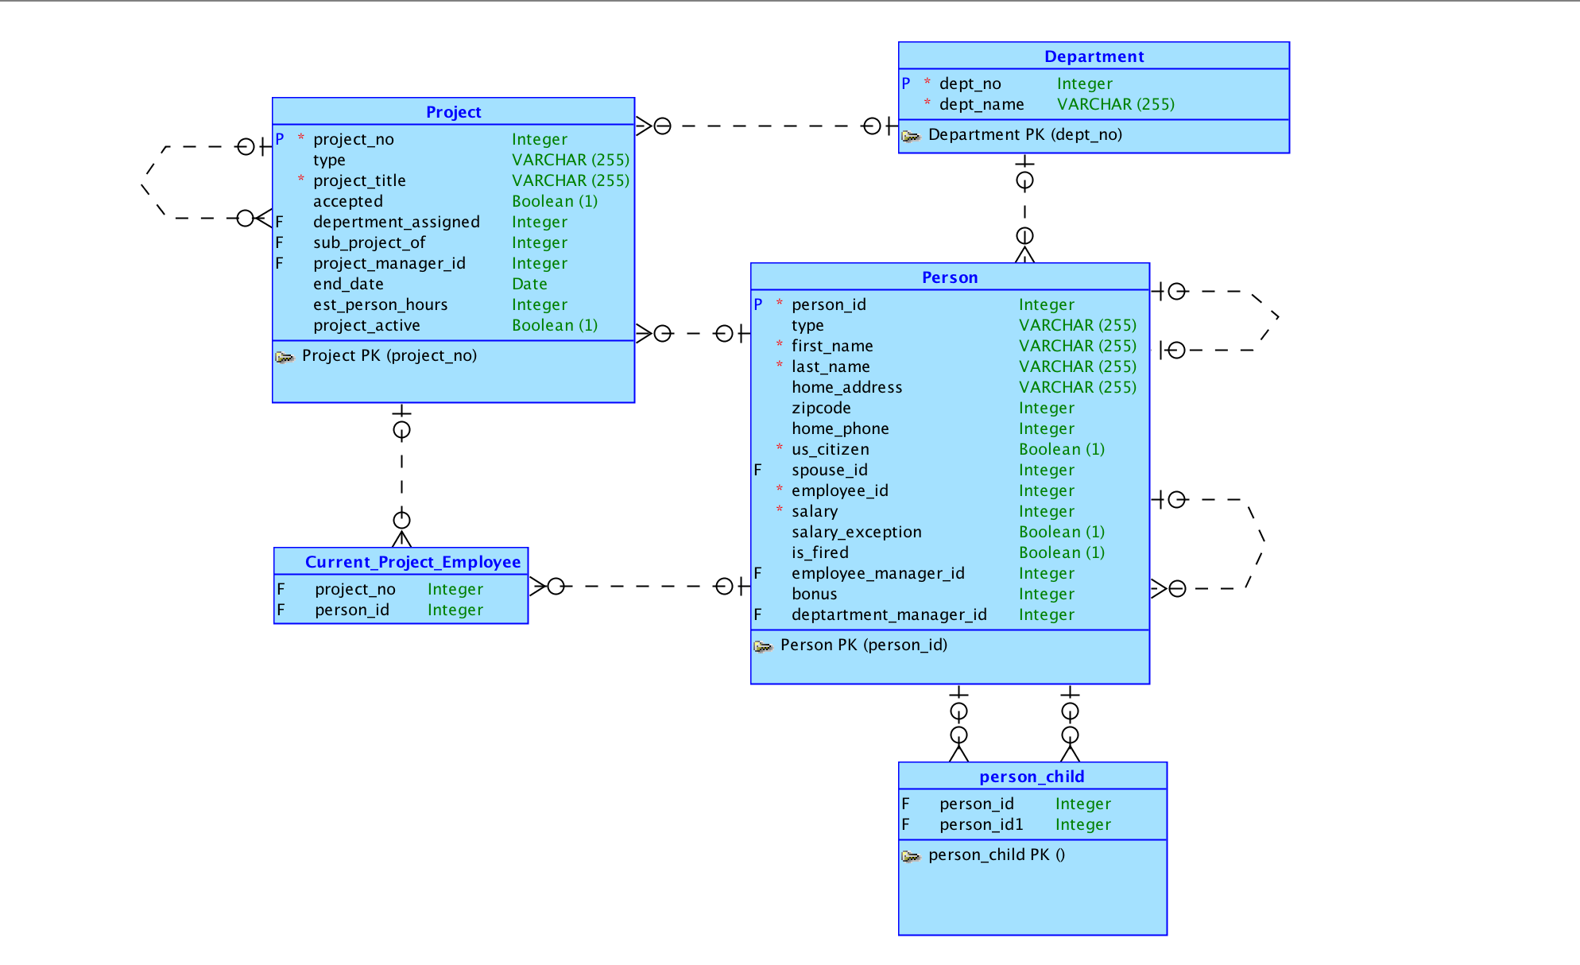
Logical Model

Slide 5
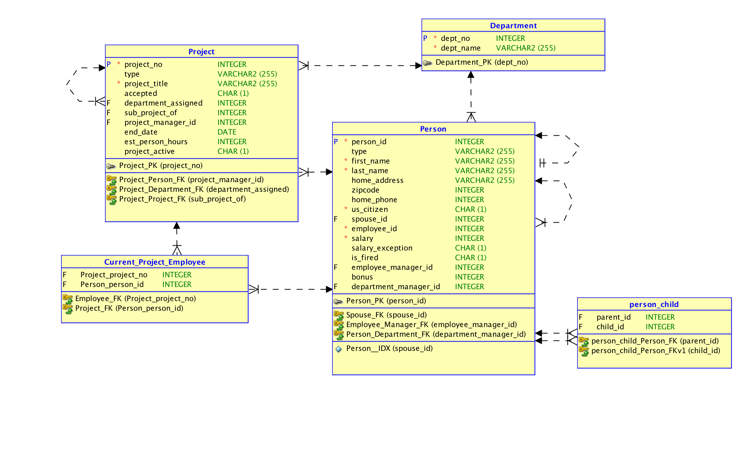
Relational Model

Slide 6
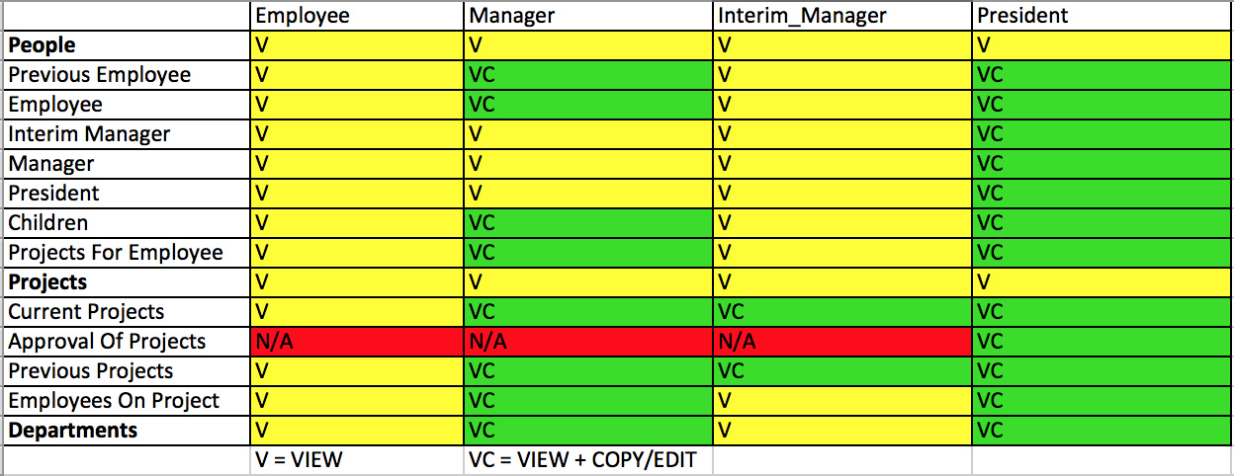
Permissions

Slide 7
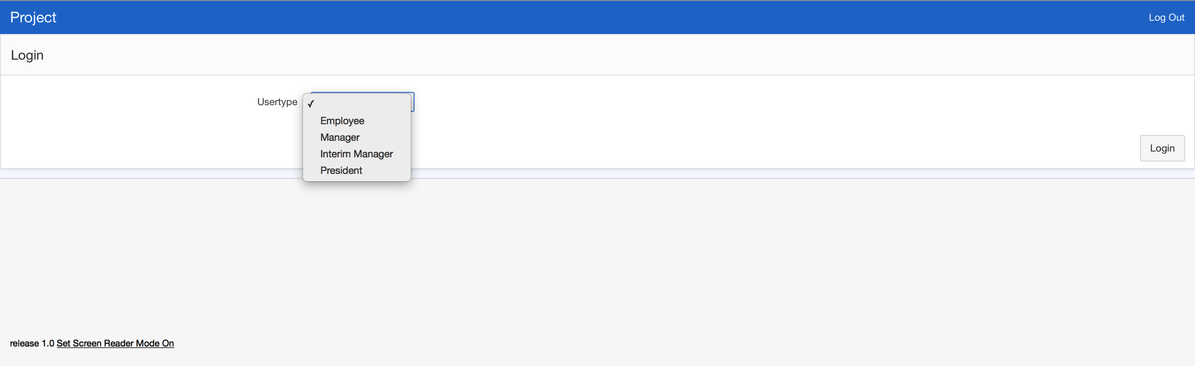
Login

Slide 8
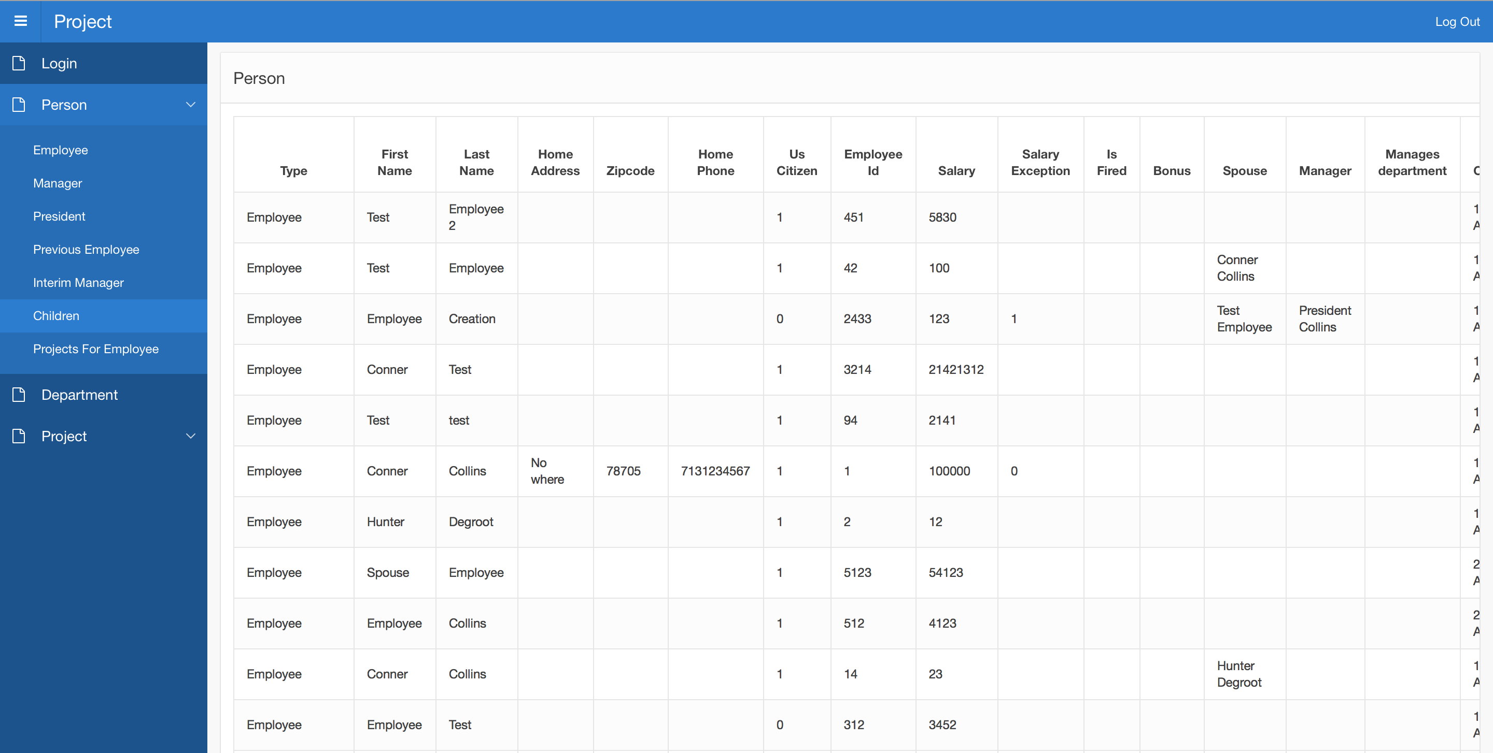
Person

Slide 9
Person Extended

Slide 10
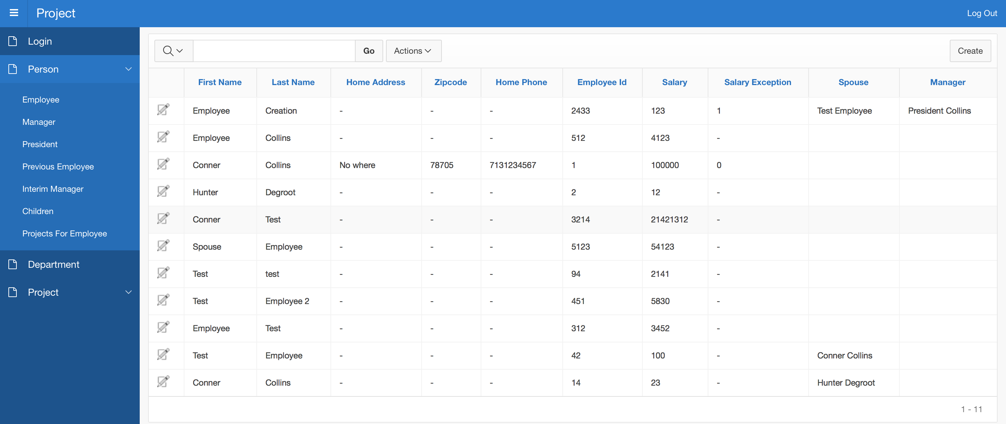
Employee (President View)

Slide 11
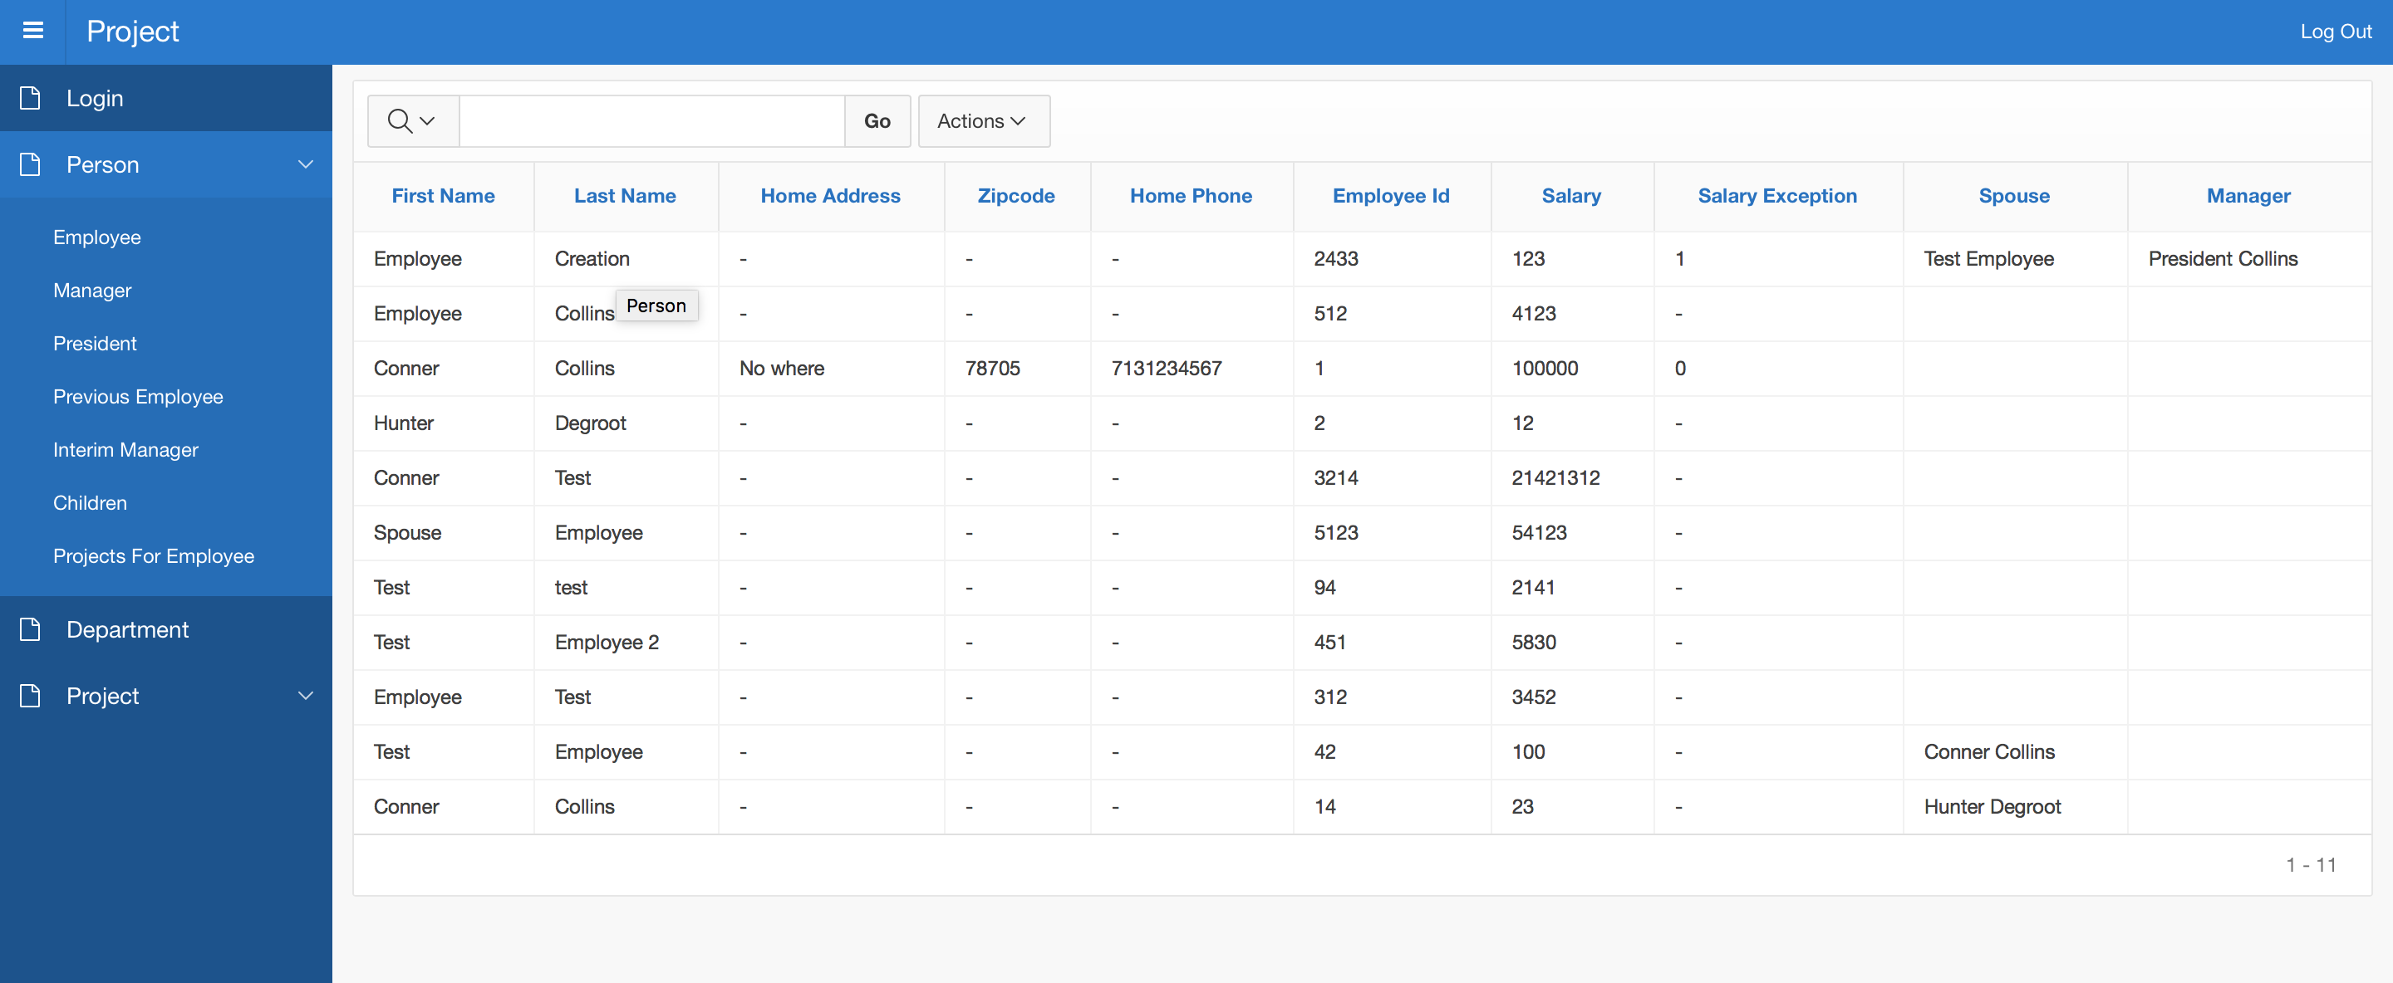
Employee (Employee View)

Slide 12
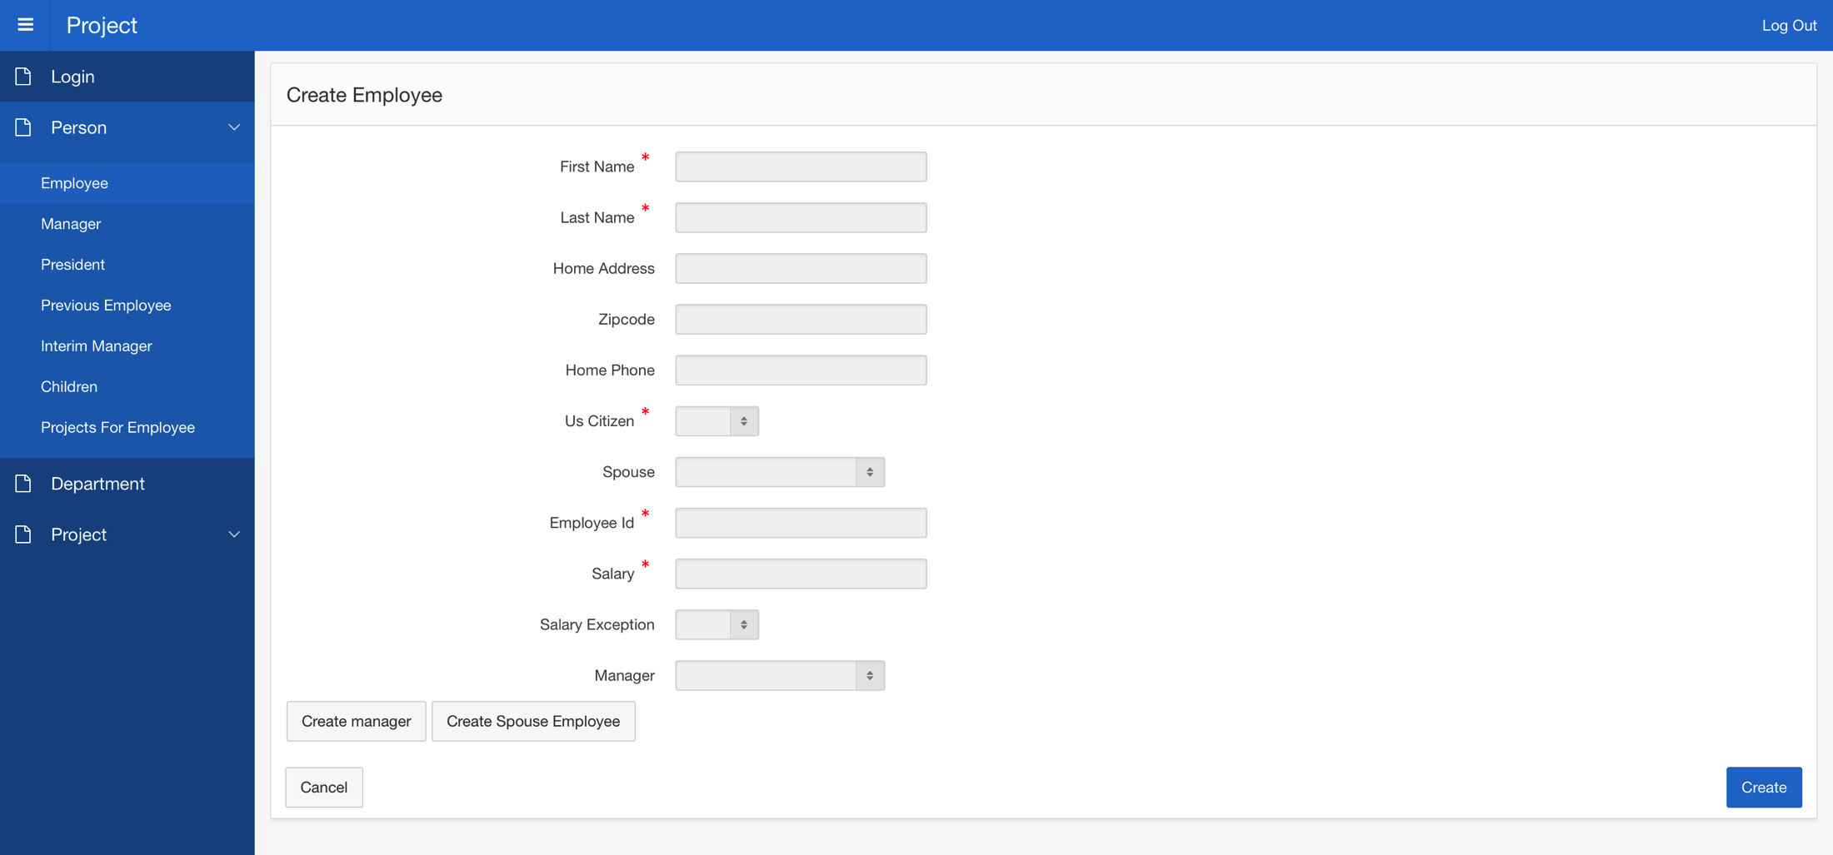
Create Employee

Slide 13
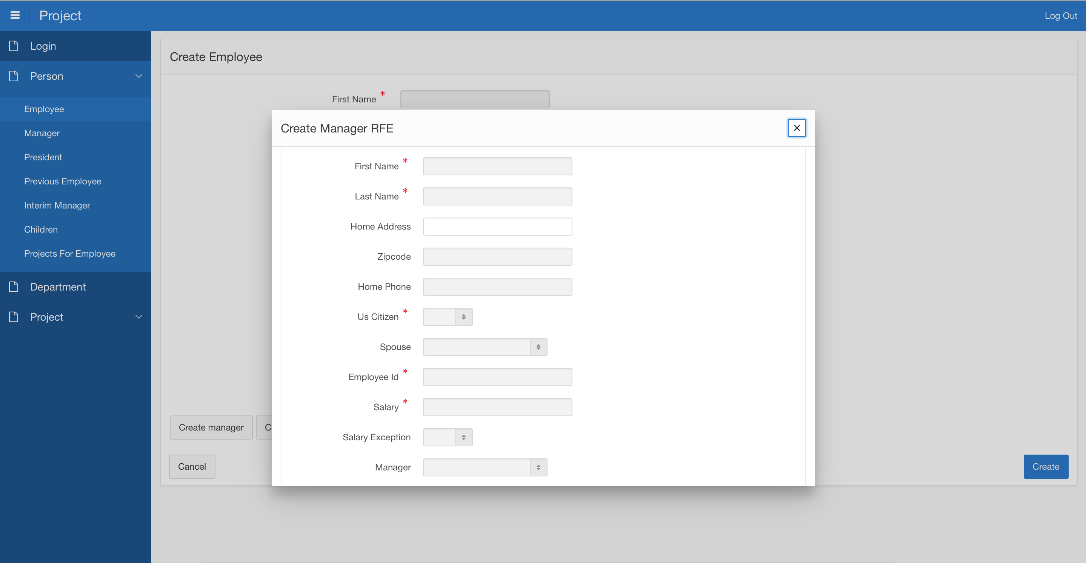
Create Manager Within Employee Form

Slide 14
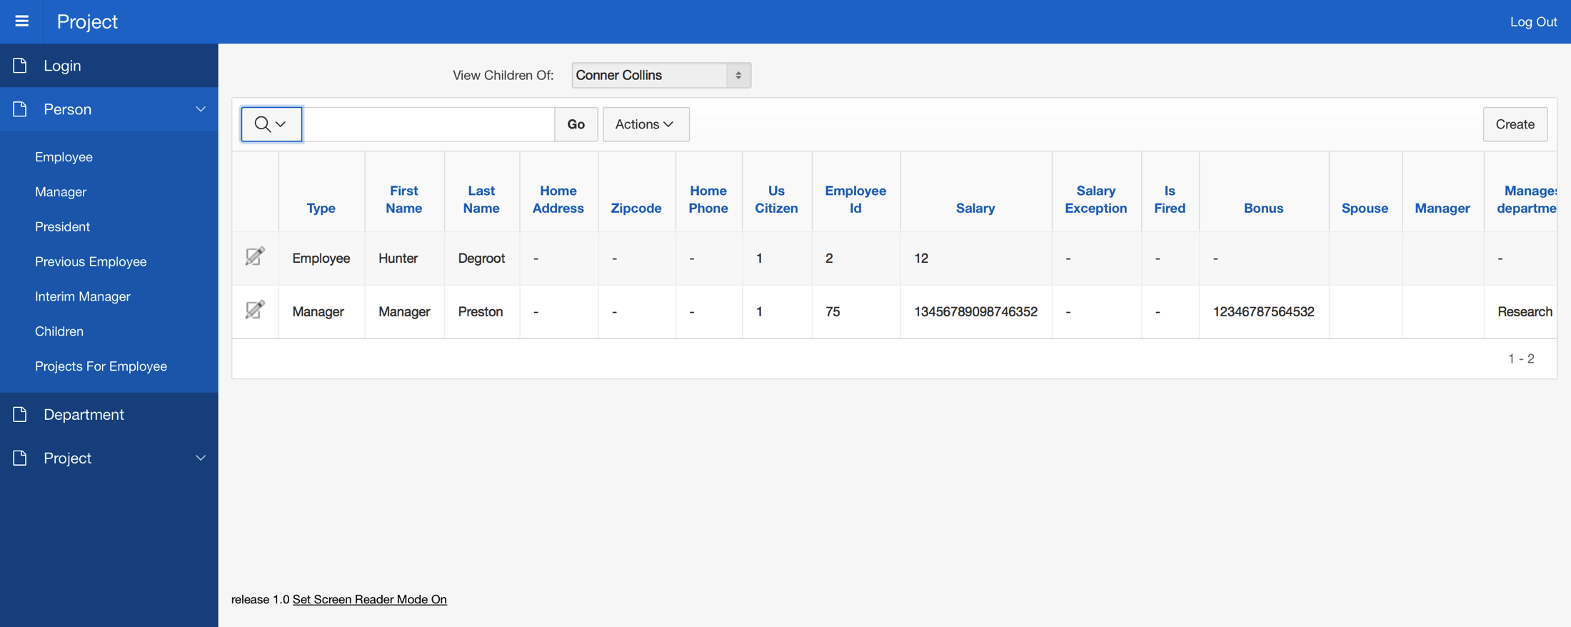
Children Many to Many Relationship

Slide 15
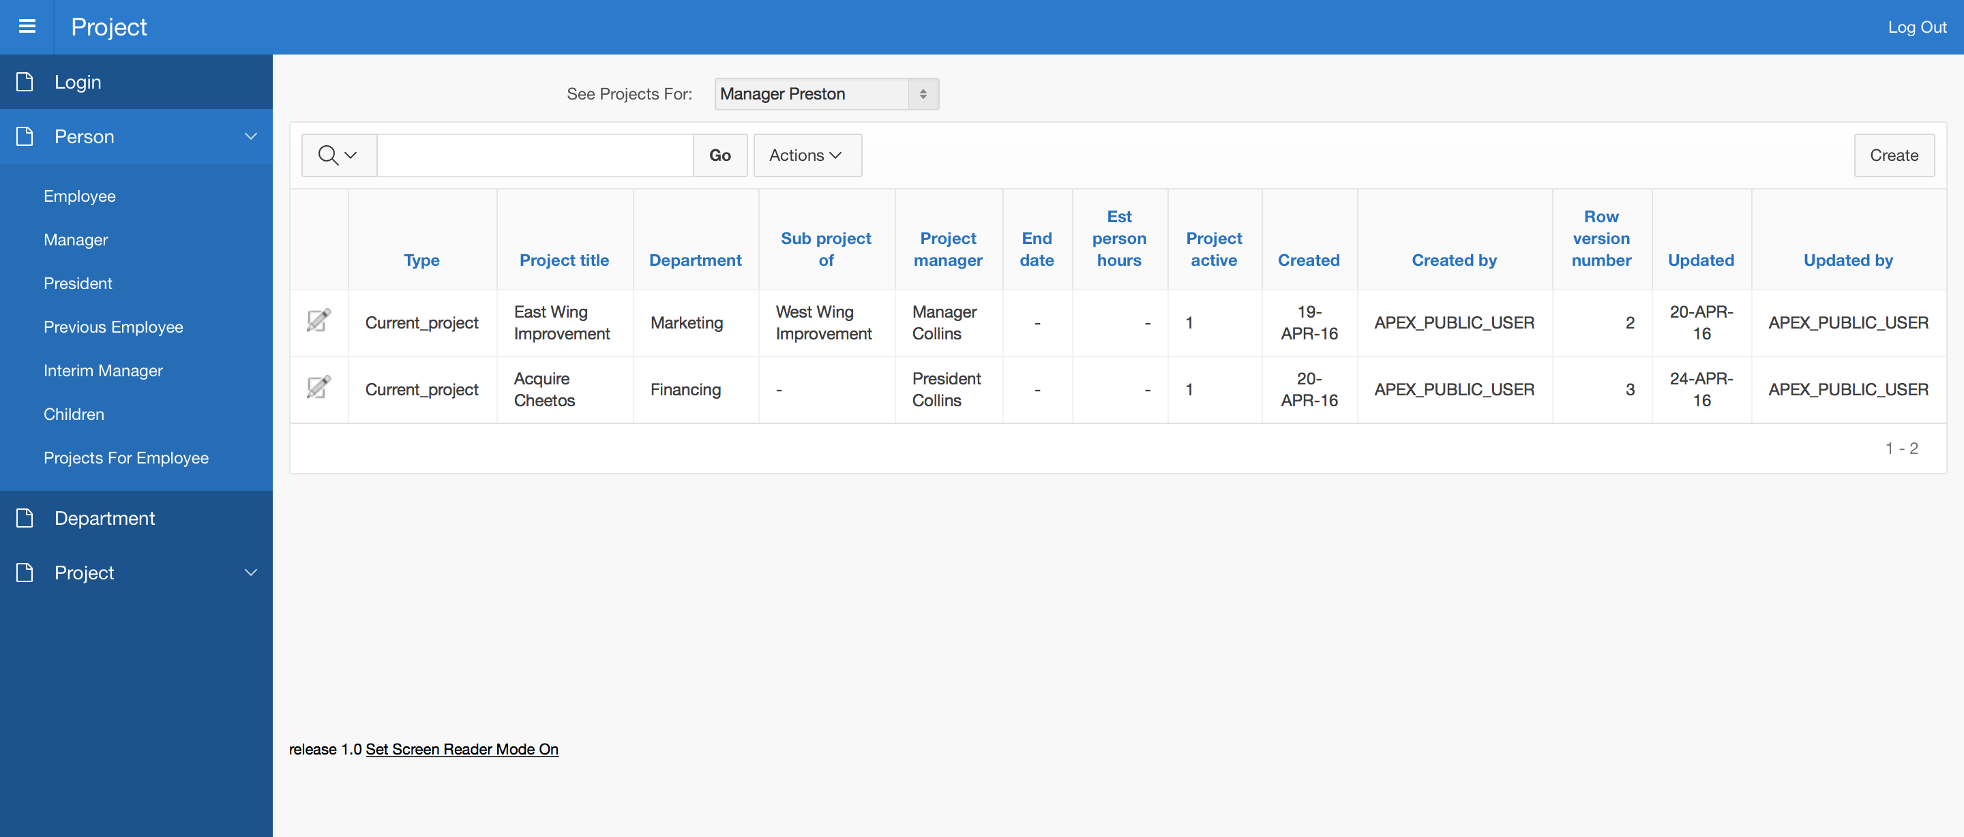
Projects Employees Are On

Slide 16
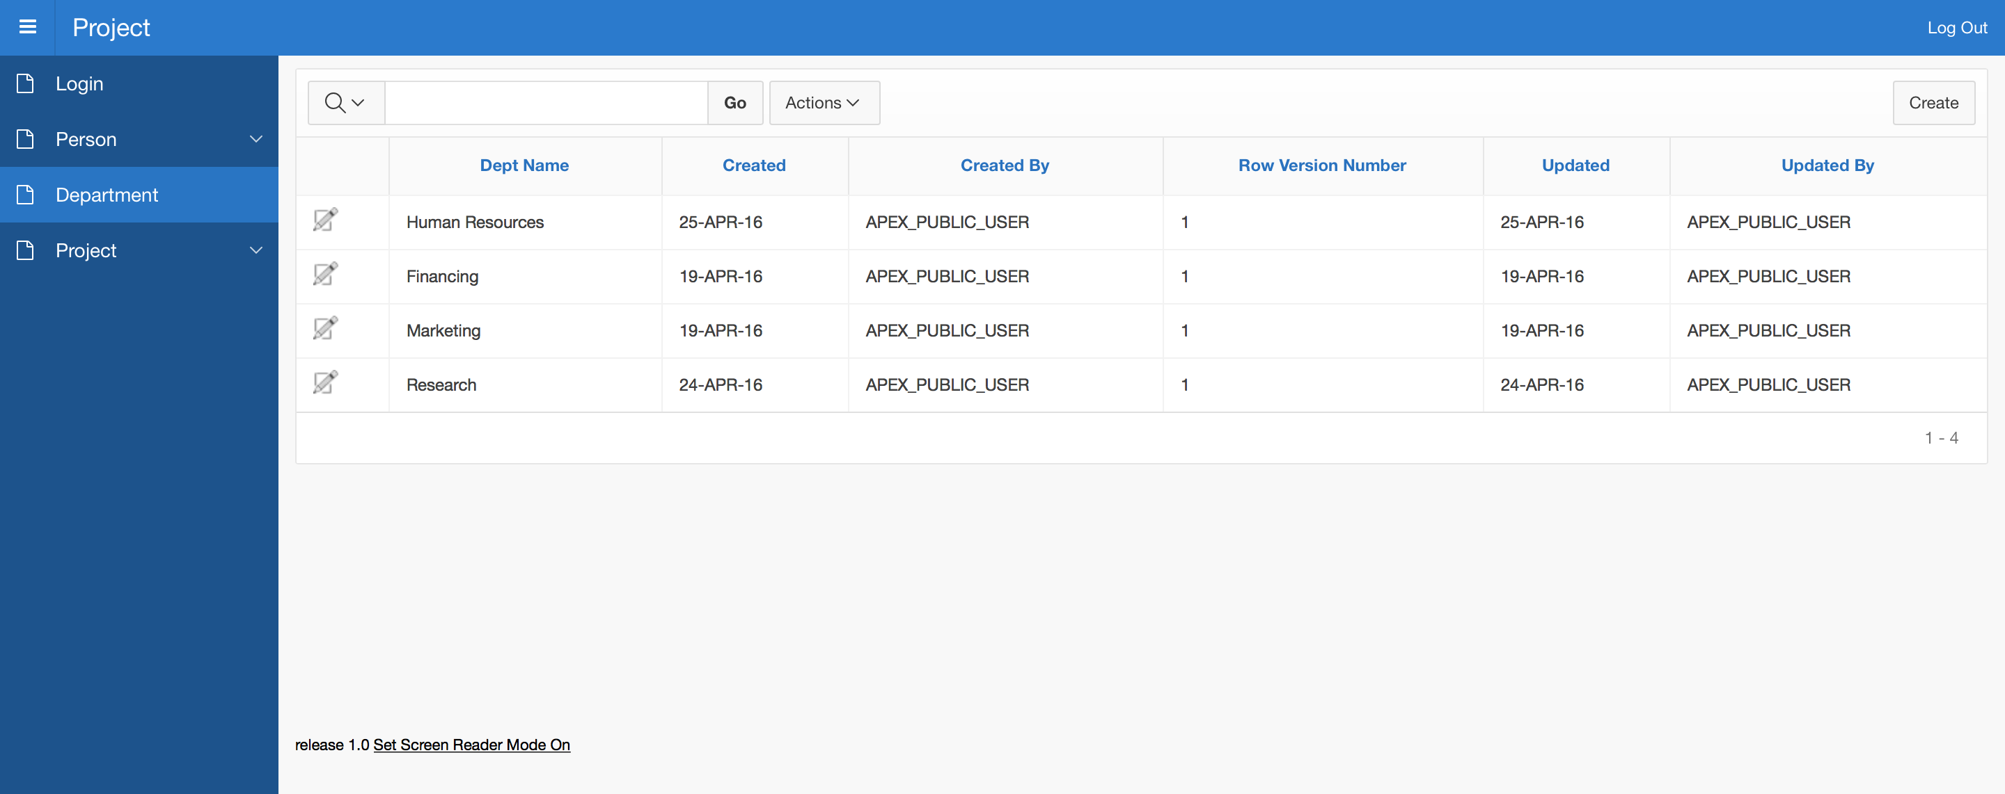
Department

Slide 17
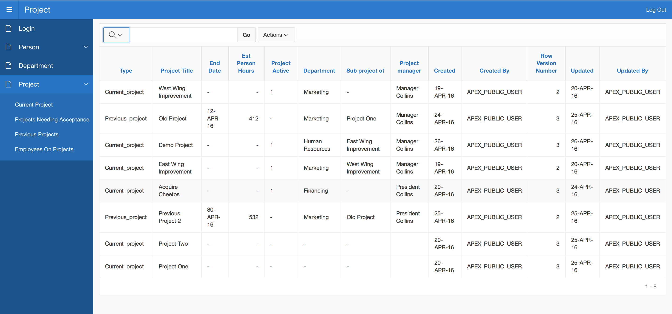
Projects

Slide 18
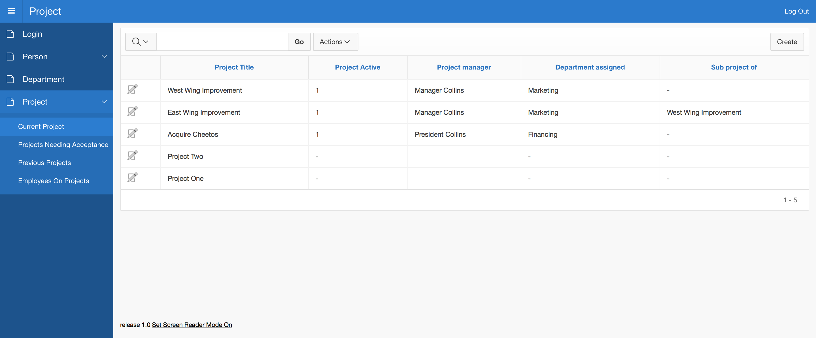
Current Project

Slide 19
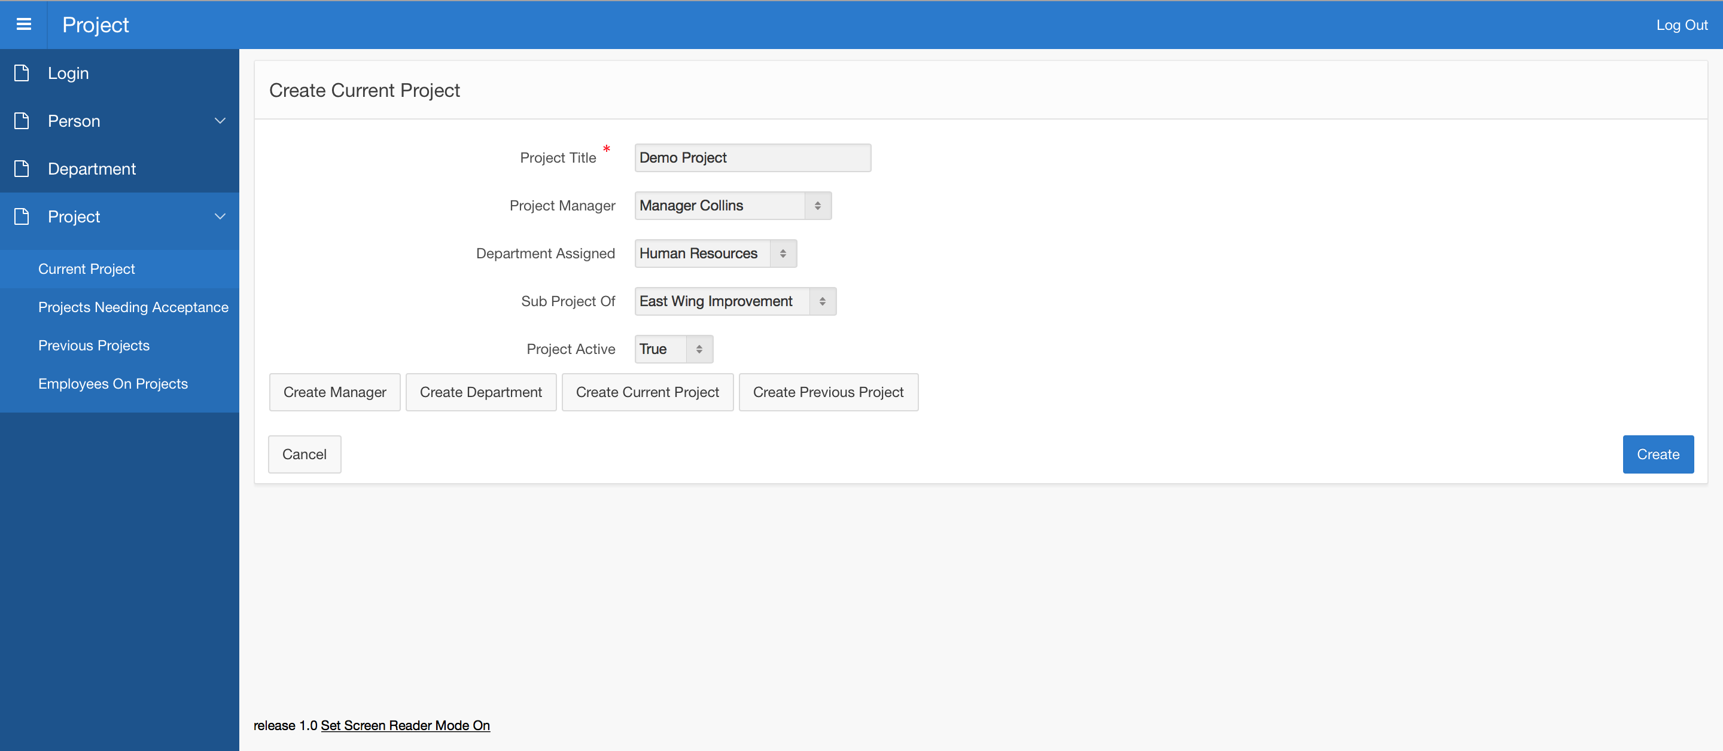
Create Current Project

Slide 20
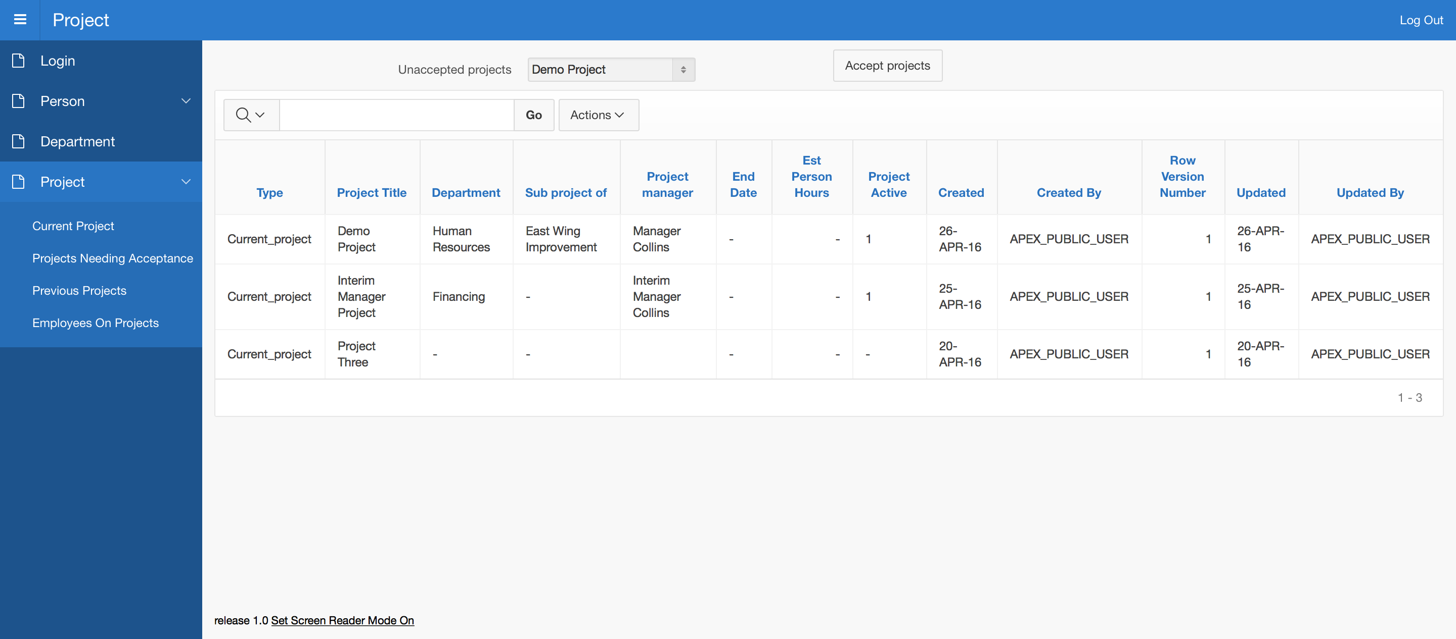
Accept A Project

Slide 21
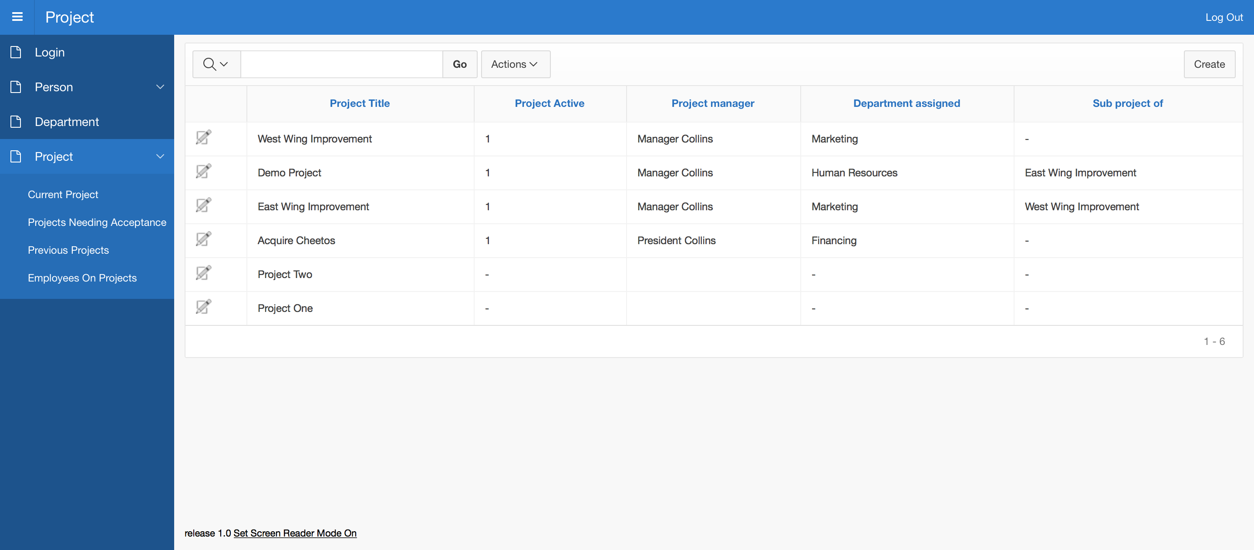
Current Project After Approved

Slide 22
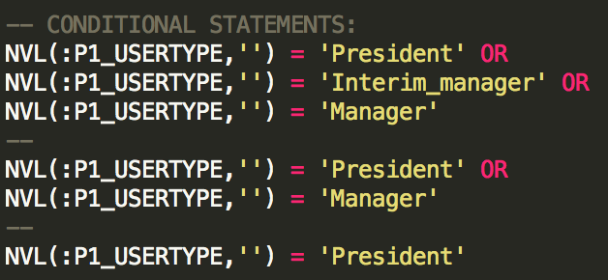
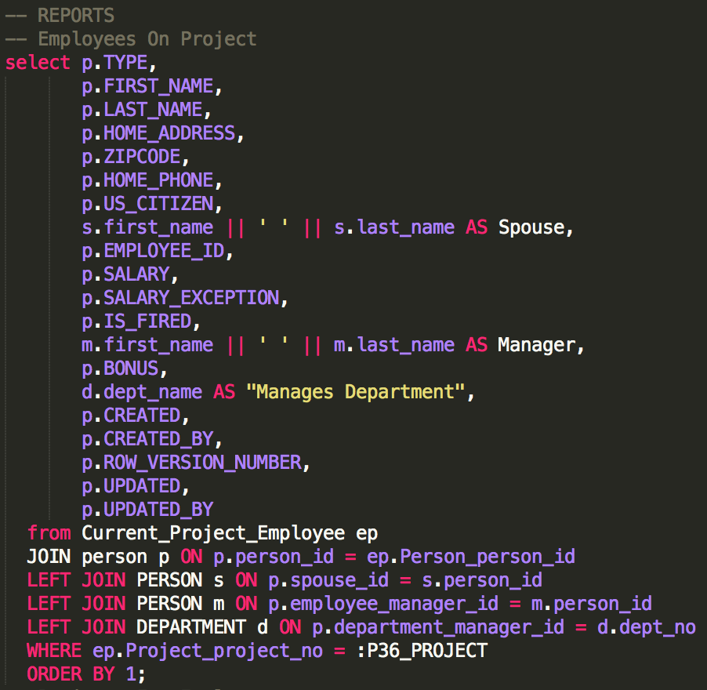
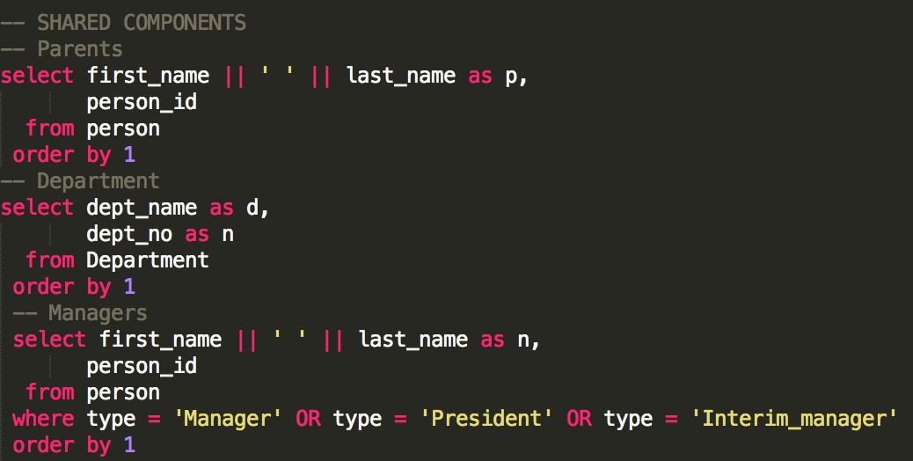
Sample Queries

Slide 23
Part 2
Models
Screenshots
SQL Queries

Slide 24
Insert Part 2 Req. Presentation Stuff Here

Slide 25
SIM Questions And Recommendations:
Insert Stuff

